Slide 1

ITAP 3 : ‘Provide high quality feedback’.
DO NOW:
Discuss on your tables your understanding of the core readings and how they reflected what you observed in practice in school settings.
Challenge: What were the techniques used for students with SEND or multilingual learners?

Slide 2
Aims of the sessions:
Share critique of observed practice in focus groups.
Critique of school’s assessment or feedback policies.
Presentation of designed school feedback policy and rationale.
Exploring how this looks like in subject area

Slide 3
Link with ITTECF
Learn that:
CCF6.1 - Effective assessment is critical to teaching because it provides teachers with information about pupils’ understanding and needs.
CCF6.5 High quality feedback can be written or verbal; it is likely to be accurate and clear, encourage further effort, and provide specific guidance on how to improve.
CCF6.6 - Over time, feedback should support pupils to monitor and regulate their own learning.
Learn how to provide high quality feedback by:
CCF6i) Focusing on specific actions for pupils and providing time for pupils to respond to feedback.
CCF6j) Appreciating that pupils’ responses to feedback can vary depending on a range of social factors (e.g. the message the feedback contains or the age of the child).
CCF6k) Scaffolding self-assessment by sharing model work with pupils, highlighting key details.
CCF6l) Thinking carefully about how to ensure feedback is specific and helpful when using peer- or self-assessment.

Slide 4
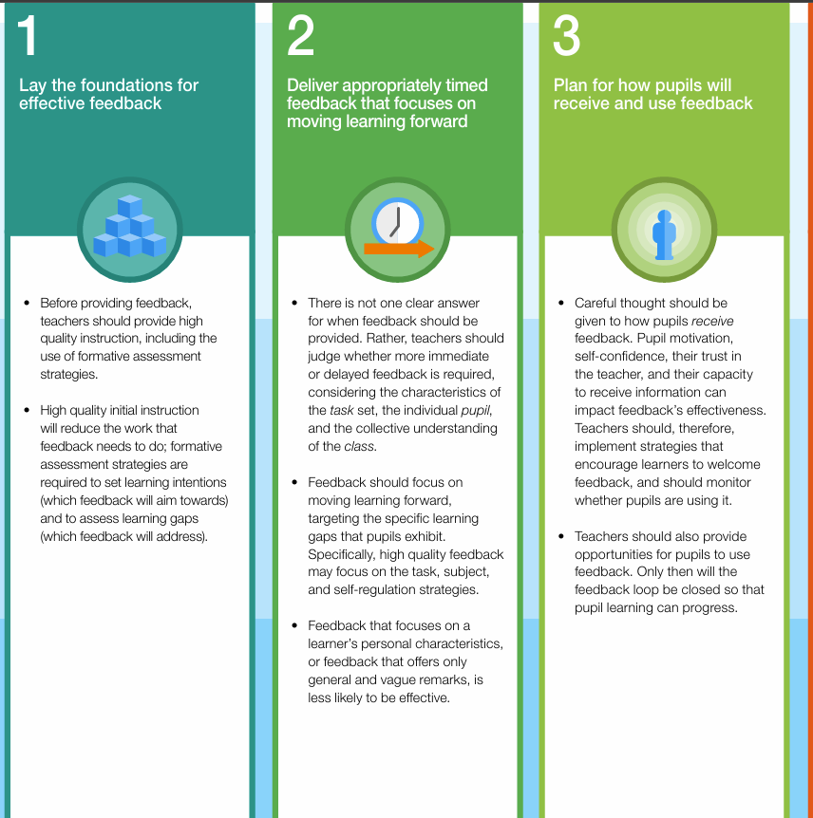
Revisiting the Education Endowment Foundation (2021) Teacher Feedback to Improve Pupil Learning Guidance Report.
Considering the first 3 recommendations of the EEF: discuss on your table focussing on the observations you made in school settings how each of the aspects of the guidance were put in practice with expert colleagues.
What was highly effective?
What were the challenges?
What was the impact on the learning of the students?

Slide 5

Capture here your 3 take aways from the discussion
What will you consider when planning effective feedback?
Help:
Consider using a concept map or the grid at the back of the observation form to map out the different types of feedback and their impact on engagement and moving learning forward

Slide 6

Exploring school feedback for learning policies
In pairs revisit your school assessment & feedback policy.
What is the rationale behind your school policy?
How are assessments planned?
What are the expectations for feedback for learning?
How does this reflect the Government guidance for feedback to be " meaningful, motivating and manageable"?
How does this work in practice in your subject?
Help:
Consider the documents handed in to you by your mentors or PCM or check your school webiste

Slide 7
Feedback feedforward in subject area
Here subject lecturers may choose to bring subject specific approach to feedback feedforward
Puposeful feedback in science using BEST resources

Slide 8
Audience participation
What is it to be “alive”?
Age 0-5: No concept of ‘alive’.
Age 6-7: Anything that is active in any way (e.g. makes a noise) is alive.
Age 8-9: Only (and all) things that move are alive.
Age 9-11: Things that move by themselves are alive.
Age 11+: Only animals, or animals and plants, are alive.
Biology > Big idea BCL: The cellular basis of life > Topic BCL1: Cells

Slide 9
Audience participation
Still common for MRS GREN to be taught up to age 11
This model isn’t perfect, and difficult to convince children that plants (and other organisms) comply
Introduce cells, organs, systems from 11 onwards
36% of children aged 14-15 used cellular respiration as a criterion for life (Arnold and Simpson, 1979)
Biology > Big idea BCL: The cellular basis of life > Topic BCL1: Cells

Slide 10
Imagine that an alien spaceship is firing its death rays at Earth! The death rays will destroy everything that is made of cells. Things that are not made of cells will not be affected.
Statements |  | Student 1 | Student 2 | Student 3
1 | People will be destroyed. | I am sure this is right | I am sure this is right | I am sure this is right
2 | Brick walls will be destroyed. | I am sure this is wrong | I am sure this is wrong | I am sure this is wrong
3 | Plants will be destroyed. | I am sure this is right | I am sure this is wrong | I am sure this is right
4 | Very small organisms will not be destroyed. | I am sure this is right | I am sure this is right | I am sure this is wrong
5 | Dead bodies will be destroyed. | I am sure this is right | I am sure this is right | I am sure this is wrong
6 | Bacteria will be destroyed. | I am sure this is wrong | I am sure this is wrong | I am sure this is right

Slide 11
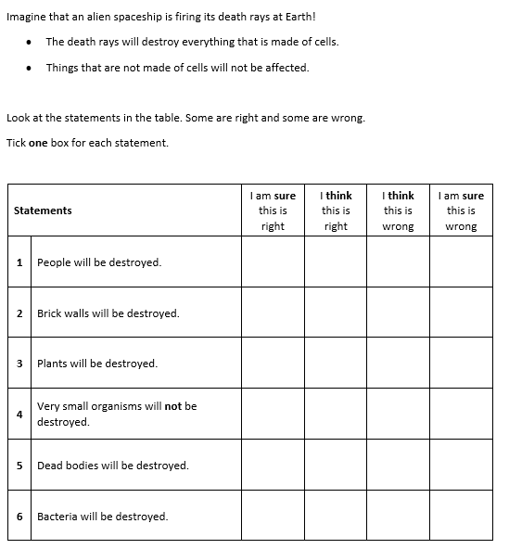
Students who choose incorrectly for statements 4 and 6 may have misunderstanding that some organisms are too small to be made of cells.
Students who choose incorrectly for statements 3, 4 and 6 may have misunderstanding that only animals are made of cells.
Students who choose incorrectly for statement 5 may have the misunderstanding that material that was once living but is now dead ceases to be made of cells.
If students have misunderstandings about which types or sizes of organisms are made up of cells, they may benefit from looking at different types of cells from different organisms using a light microscope
Response activity: What is it made of?
Biology > Big idea BCL: The cellular basis of life > Topic BCL1: Cells

Slide 12
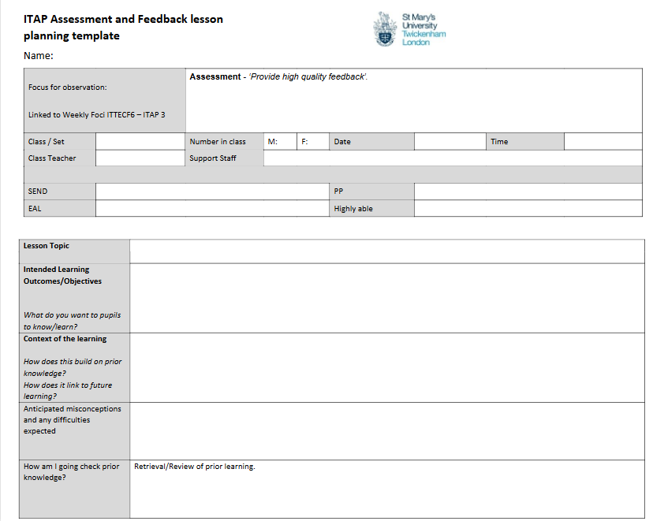
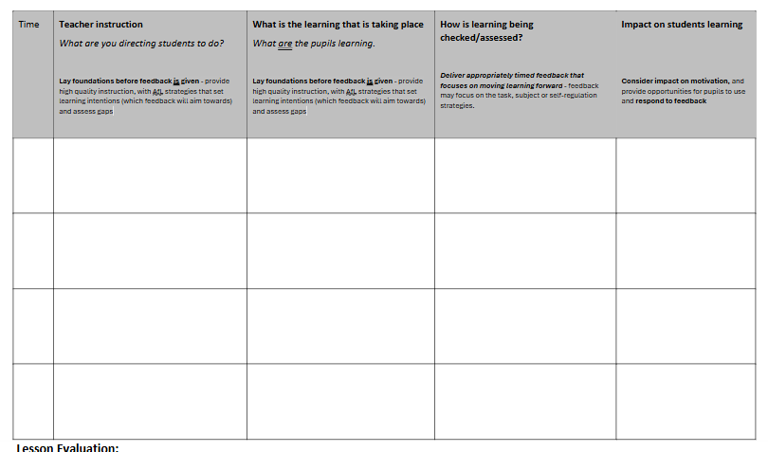
Planning time
Using the Lesson planning template to emphasise consideration of 3 principles and 2 methods of high-quality feedback- plan your lessons for Day 4
Planning form here

Slide 13
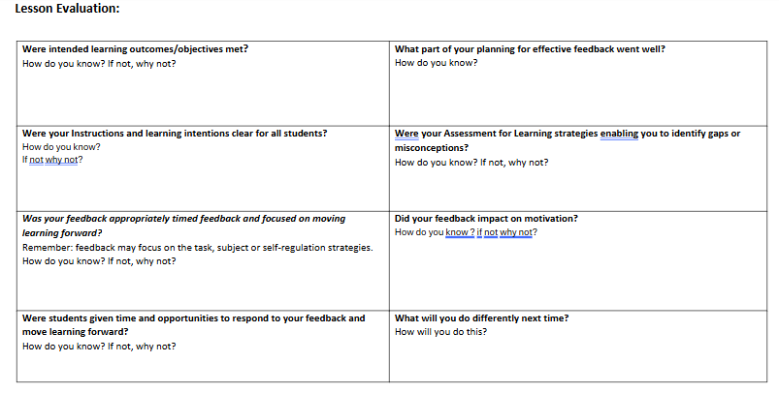
Evaluation post lesson (preparation for Day 5)

Slide 14
Lunch / break

Slide 15
Afternoon session:
Presentation and critique of lesson plans in small groups.
Review / modify own plan
Reviewer:
How has your partner laid the foundation before feedback is given ? provide high quality instruction, with AfL strategies that set learning intentions (which feedback will aim towards) and assess gaps?
How has your partner planned to deliver appropriately timed feedback that focuses on moving learning forward in the lesson? feedback may focus on the task, subject or self-regulation strategies.
How has your partner planned for how pupils will receive and use feedback ? consider impact on motivation, and provide opportunities for pupils to use and respond to feedback

Slide 16

Day 5 planning
Present critique of own lesson in small groups, connected to literature. Include proposed feedback policy and recommendations for future practice.

Slide 17
Aims of the sessions:
Share critique of observed practice in focus groups.
Critique of school’s assessment or feedback policies.
Presentation of designed school feedback policy and rationale.
Exploring how this looks like in subject area

Slide 18
References:
Education Endowment Foundation (2021) Teacher Feedback to Improve Pupil Learning Guidance Report. [Online]. Available at: https://d2tic4wvo1iusb.cloudfront.net/production/eef-guidance-reports/feedback/Teacher_Feedback_to_Improve_Pupil_Learning.pdf?v=1702275463
Summary of 7 Key Recommendations. EEF_Feedback_Recommendations_Poster.pdf (d2tic4wvo1iusb.cloudfront.net)
Education Endowment Foundation (2021) Education Endowment Foundation Teaching and Learning Toolkit, Feedback: Available at: https://educationendowmentfoundation.
Flight et al (2018) Reducing Teacher Workload Flying High Partnership for the Department for Education Crown Publishing: London available at: Flying High - Reducing teacher workload
ELlminating Unnecessary workload around marking ( Government Review 2016) available at: Eliminating unnecessary workload around marking
Subject specific readings:
https://livesmucac.sharepoint.com/:w:/s/PGCESecondary2024-25/Edk6qcE4ub1LvjyUMkQaJ5MBparuRRwZGZeZxqRJS5p05Q?e=UqSAly

